Slide 1

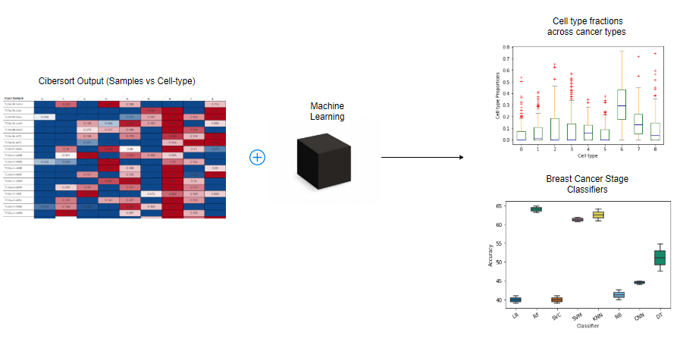
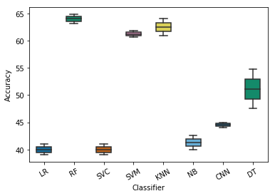
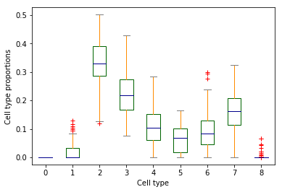
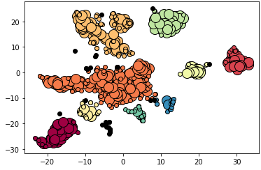
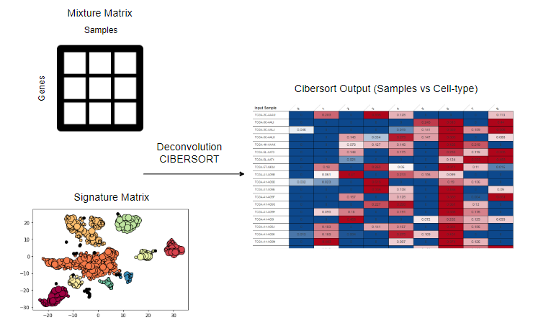
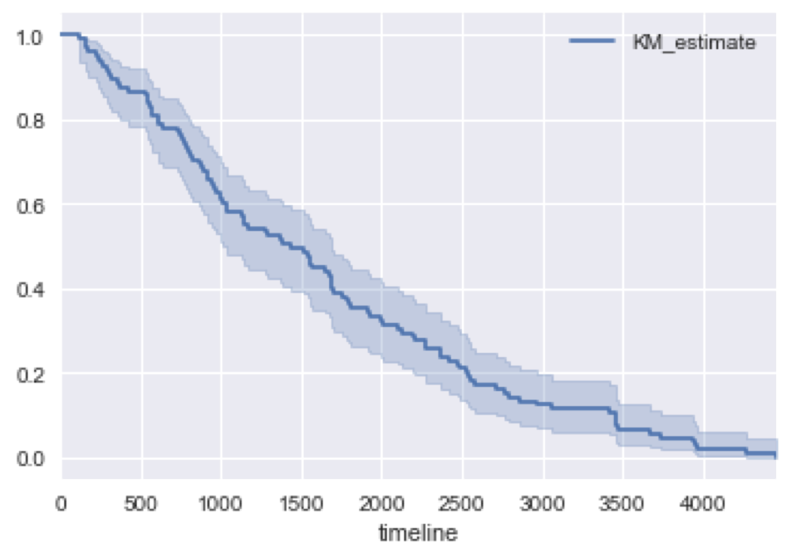
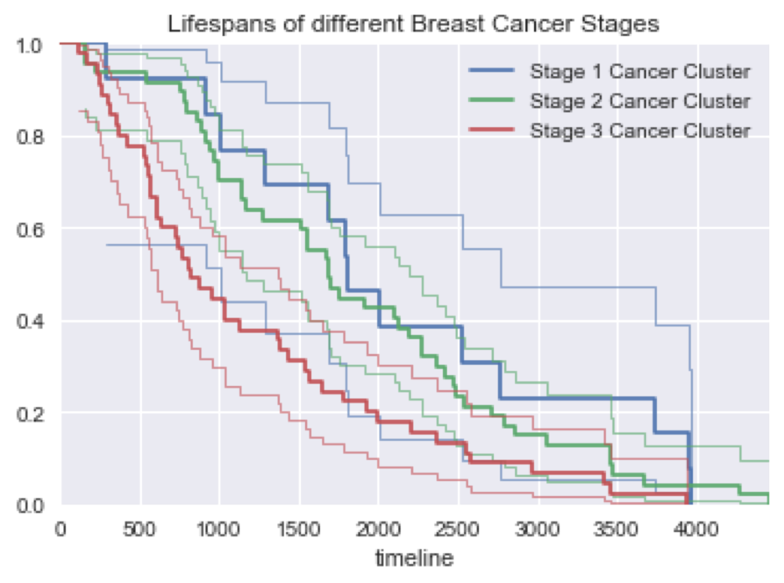
Single cell transcriptome deconvolution of breast cancer tissues reveals the cell fraction changes associated with cancer stages
Rahul Bhansali¹, Neha Mane², Daifeng Wang³
¹Master’s student, Department of Computer Science; ²Master’s student, Department of Computer Science; ³Department of Biomedical Informatics, Stony Brook University, Stony Brook, NY, USA
Abstract
Flowchart depicting the process to create the ML classifier
Classification Performance
In this study, we classify the single-cell data into clusters of
cell-types. We then apply single-cell deconvolution on the
TCGA-BRCA dataset to obtain the cell-type proportions of
each sample. We use the clinical data of the TCGA-BRCA
patients and machine learning to create classifiers that can
predict the breast cancer stage of a patient with
approximately 65% accuracy given the cell-type proportions
of a breast cancer patient. We also compare the
differentially expressed cell-type proportions between
healthy and breast cancer patients. Finally, we analyze
differentially expressed cell-types among patients having
different survival rates.
Model | Accuracy
Multi-Class Logistic Regression | 40.44%
Random Forest | 64.91%
Linear SVC | 40.65%
Linear SVM | 60.63%
kNN Classifier | 64.10%
Naive Bayes | 42.58%
CNN | 44.66%
Decision Tree | 54.76%
Data and Approach
Single cell RNA-seq data of primary breast cancer for 11 patients was obtained from the NCBI Gene Expression Omnibus while the bulk and clinical datasets were taken from TCGA Cancer Project. The datasets were preprocessed and the Signature Matrix and Mixture Matrix were generated. The Signature Matrix was generated by clustering marker genes into cell types and averaging the gene expression across cluster.
Classifier results and cell type proportions
t-Distributed Stochastic
Neighbor Embedding (t-SNE)
DBSCAN
Conclusion
Classified single-cells into 9 different cell type clusters.
Created a Random Forest Classifier to predict breast cancer stage with 65% accuracy.
Found differentially expressed cell-types for healthy v/s breast cancer patients.
KM Survival Plots of Breast Cancer Patients
References
Clusters of similar cells observed after applying t-SNE on the single cell RNA-seq data
Single Cell Sequencing, Wikipedia: https://en.wikipedia.org/wiki/Single_cell_sequencing
Schelker, Max et al. Estimation of immune cell content in tumour tissue using single-cell RNA-seq data, 2017, Nature Communications Article 2032 Volume 8 DOI: https://doi.org/10.1038/s41467-017-02289-3
TCGA-BRCA dataset - https://portal.gdc.cancer.gov/projects/TCGA-BRCA
CIBERSORT, https://cibersort.stanford.edu/
Kaplan, E. L.; Meier, P. (1958). "Nonparametric estimation from incomplete observations". J. Amer. Statist. Assoc. 53 (282): 457–481. DOI: 10.2307/2281868
KM survival plot of Breast Cancer Patients with 95% Confidence Intervals.
KM survival plots for different stages of Breast Cancer Patients with 95% Confidence Intervals. The lines in bold show the survival line. The same colored lighter lines depict the 95% Confidence Interval line for that breast cancer stage.
Steps involved in obtaining cell-type fractions of each breast cancer patient

